Slide 1
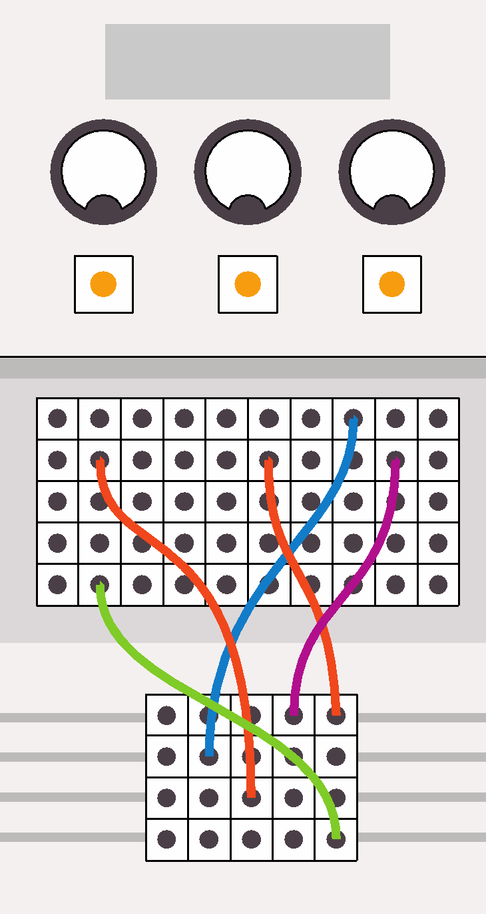
Computing:
past, present and future
Lesson 5: Learning to present

Slide 2
Objectives
In this lesson, you will:
learn how to deliver a good presentation
prepare and deliver a presentation about the history of computing
evaluate the presentations delivered by your classmates.

Slide 3
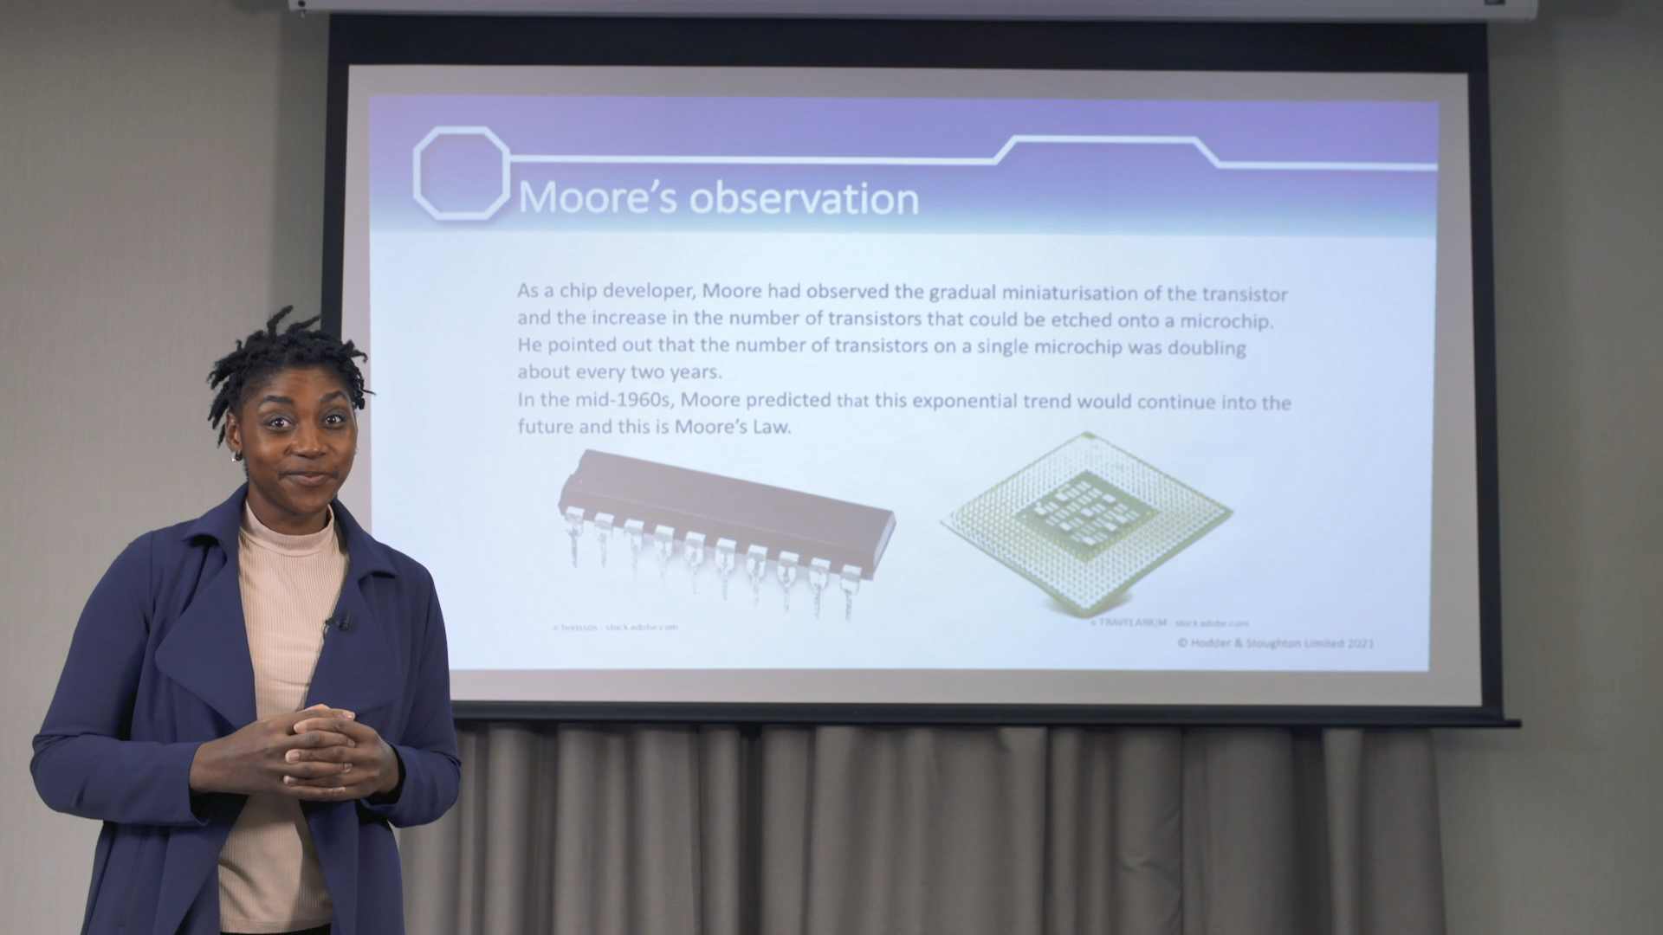
Who delivers the better presentation?
Watch Videos 5.1 A and B

Slide 4

The dos and don’ts of good presentations
DO
Look at the audience.
Talk about the information on the slides.
Speak loudly and clearly.
Give the audience time to fully absorb the information on each slide before moving on.
Keep to the time limit you’ve been given.

Slide 5

The dos and don’ts of good presentations
DON’T
Stand in front of the screen.
Stand with your back to the audience.
Read the text on the slides.
Talk too quickly, mumble or gesticulate
too much.
Move through the slides too quickly.
Overrun the time limit you’ve been given.

Slide 6

Activity 5.1: Rehearsing your presentation
Rehearse your two-minute presentation on the history of computing.
If you are working in pairs or groups, decide which slide or slides each of you will be presenting.
Work out what you want to say and practise giving the presentation as many times as you can. Practise, as they say, makes perfect.

Slide 7
Activity 5.2: Delivering the presentations

Slide 8
Quiz 5

